Slide 1

Arduino Sound Reactive LED

Slide 2
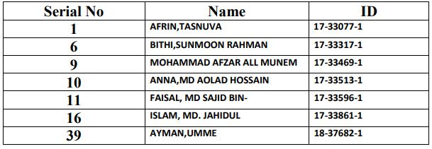
Group members:
COURSE NAME: ELECTRONIC DEVICES LAB
COURSE TEACHER: SADIA YASMIN

Slide 3
OBJECTIVES
Introduction
Components
Connection
Code part & Functionality
Cost
Applications
Limitations
Final discussion and conclusion

Slide 4
Introduction:
The topic of our presentation is the sound – Arduino sound reactive LED. This project is based on the theory of “electromagnetism”, “wave”, “sound” and “electrical circuit”. The goal of the project was to build or create a device or system with necessary components attached to it and circuit connections in parallel with the code functionality.
In this presentation these are going to be discussed accordingly and what has been done to built the system and what initiatives was taken by the project members to accomplish the task along with the system design and basic sense of ENGINEERING.

Slide 5
components
Arduino
A Sound Sensor
LED
220 ohm Resistors
Mini Breadboard
Wires

Slide 6
Built-in components of Arduino
components
Arduino
A Sound Sensor
LED
220 ohm Resistors
Mini Breadboard
Wires
Power Supply: A power supply creates a voltage across its output pins.
Resistor: A Resistor is a device that resists the flow of electricity.
Capacitor : A Capacitor is a device that can store and release electrical charge in a circuit.
Inductor: An Inductor is a device that stores electrical energy in a magnetic field.
Diode: A Diode is a device that only allows for the flow of electricity to pass in one direction.
Pushbutton: A Pushbutton is a device that either completes or interrupts the flow of electricy in a circuit.

Slide 7
Built-in components of Arduino
components
Arduino
A Sound Sensor
LED
220 ohm Resistors
Mini Breadboard
Wires
Transistor: A Transistor is a device that restricts or allows the flow of current between two contacts based on the presence or absence of current on a third contact.
Two common types of transistors are:
PNP - If the base voltage is less than the emitter voltage, then current flows from the emitter to the collector.
NPN - If the base voltage is greater than the emitter voltage, then current flows from the collector to the emitter.
{Note: The P stands for P-type semiconductor and the N stands for N-type semiconductor}
Relay: A Relay is a device that completes a connection between two contact points by means of a mechanical movement.
Photoresistor: A photoresistor is a special type of resistor that is photo (or light) sensitive i.e. the resistance changes according to how much light is on the photoresistor.

Slide 8
components
components
Arduino
A Sound Sensor
LED
220 ohm Resistors
Mini Breadboard
Wires
Sound Sensor: Sound Sensor is a small and very easy to use audio sensing board with three different outputs. The Sound Detector not only provides an audio output, but also a binary indication of the presence of sound, and an analog representation of its amplitude.

Slide 9
components
components
Arduino
A Sound Sensor
LED
220 ohm Resistors
Mini Breadboard
Wires
LED: A LED is a diode that generates a specific wavelength of light when a voltage is applied across its leads.
Resistor: A Resistor is a device that resists the flow of electricity.
Wire: A Wire is one of the most basic, and crucial components available. A wire is used to connect the components of a circuit together.
Breadboard: A Breadboard is a device that facilitates the construction and testing of circuits.

Slide 10
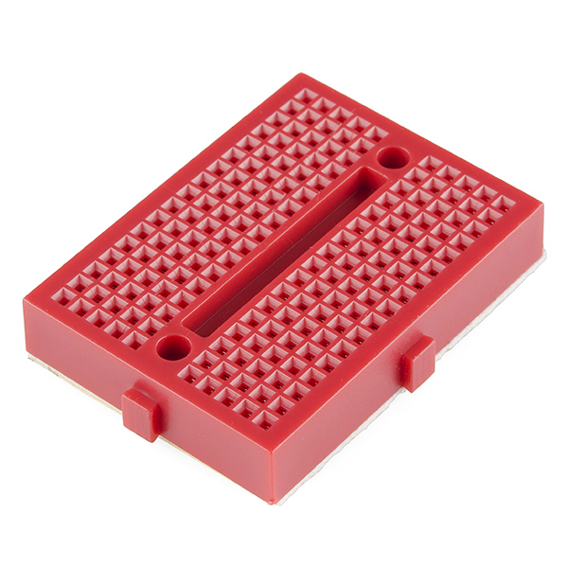
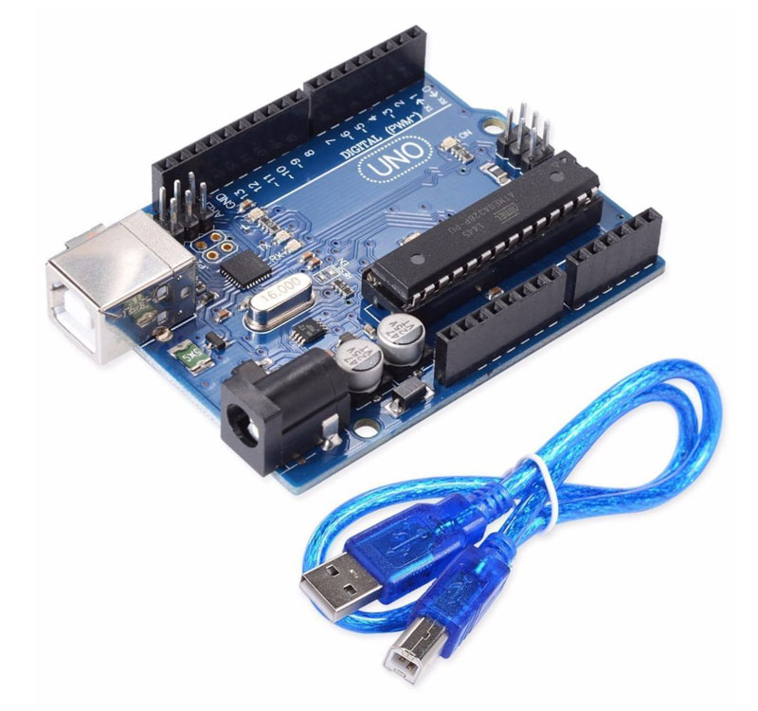
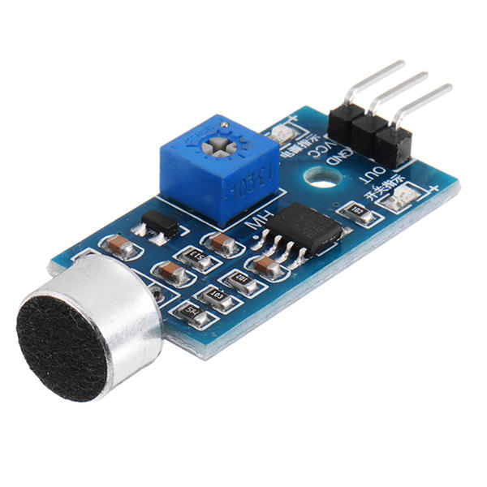
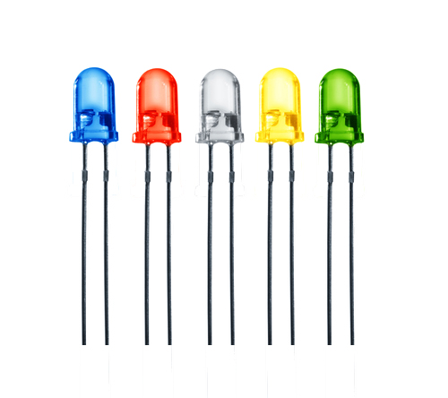
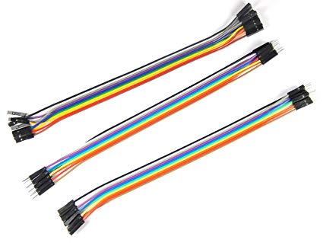
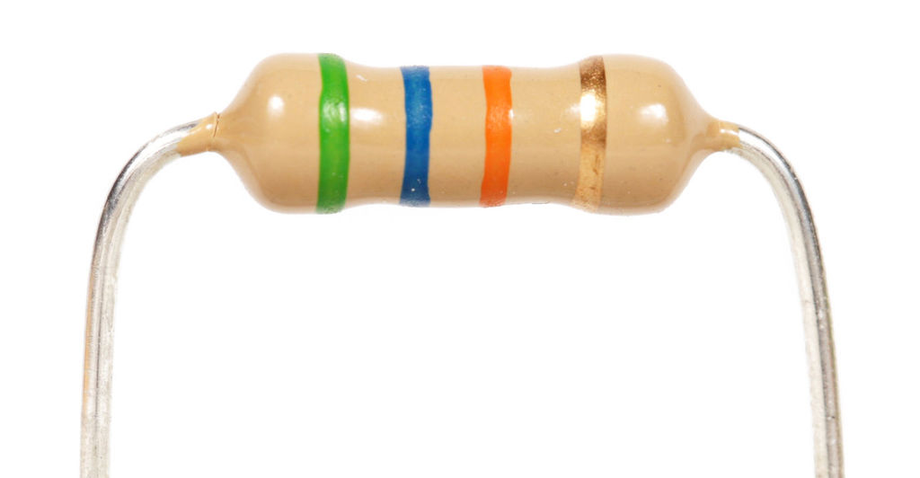
components
Arduino Sound Sensor Mini Breadboard
LEDs Wires Resistor

Slide 11
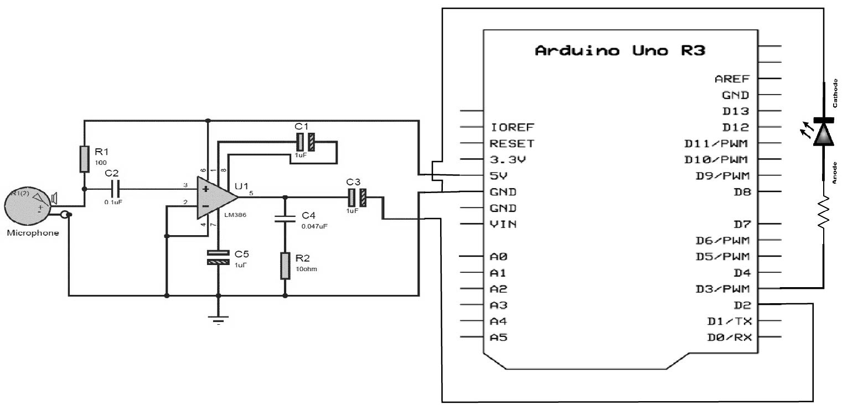
Circuit Diagram

Slide 12
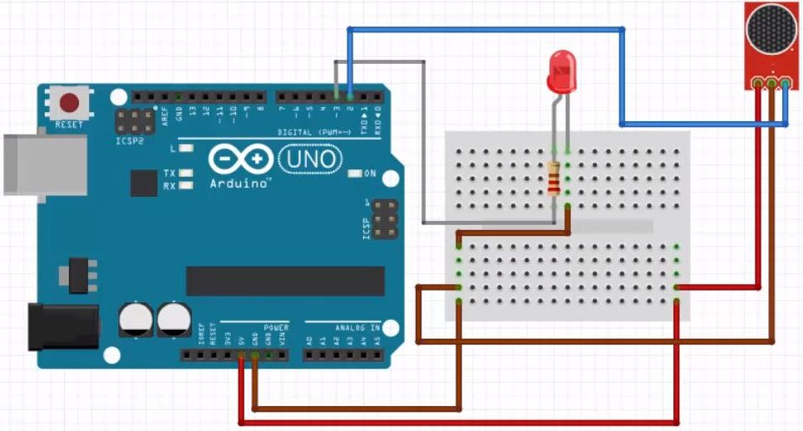
Connection
STEP -1
Connect on the mic(sensor) to the 5V pin and the (G) to the GND pin & OUT pin to 2 pin on the Arduino
STEP -2
LED place in breadboard & LED Connect (+) resistor (+) in series than resistor (+) connect to ~3 pin on the Arduino
STEP -3
Connect USB Port for power supply
LED Connect(-) to pin GND
STEP -4
Load the “program into the Arduino

Slide 13
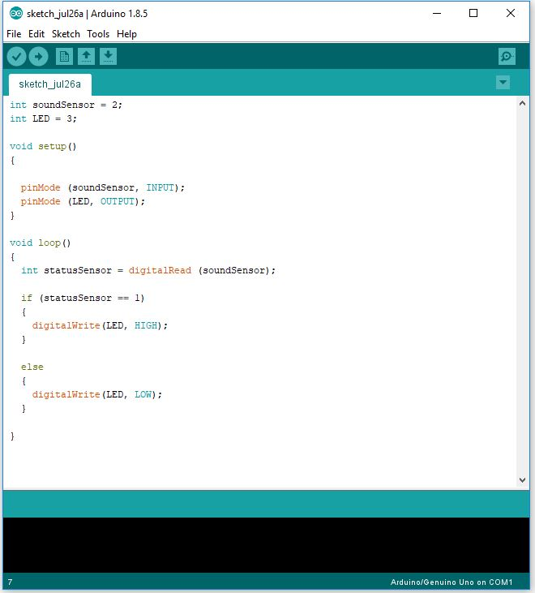
Code part & Functionality
STEP -1
Download Arduino IDE From Arduino official website.
STEP -2
Connect with USB & Select port COM1
STEP -3
Write program in IDE & verify it.
STEP -4
After successful verification than upload it in Arduino UNO

Slide 14
Cost:
The cost comparison of the actual project in the official website of Arduino uno and the slightly manipulated project in the course with some simplified sequence of actions. The cost of the manipulated product is bit less costly than the actual one: overall cost of the previous project: The cost estimation for the main project in the Arduino uno official website.
Component | Quantity | Unit Price | Cost
Jumper wire-40 pcs (male to female) & (male to male) | 2 | 80 TK | 160 TK
Arduino uno R3 | 1 | 450 TK | 450 TK
Breadboard | 1 | 150 TK | 150 TK
Sound sensor module | 1 | 135 TK | 135 TK
IR transmitter diode | 1 | 5 TK | 5 TK
Distance measurer | 1 | 150 TK | 150 TK
Total |  |  | 1050 TK

Slide 15
Cost:
The cost of the manipulated and simplified project which was done by the students:
Component | Quantity | Unit Price | Cost
Jumper wire -40 pcs (male to female) & (male to male) | 2 | 70 TK | 140 TK
Arduino uno R3 | 1 | 349 TK | 349 TK
Mini Breadboard | 1 | 47 TK | 47 TK
Sound Sensor module | 1 | 120 TK | 120 TK
LED | 3 ( 2 in backup) | 5 TK | 15 TK
Series light (blue) | 1 | 60 TK | 60 TK
Total |  |  | 731 TK
So, the total / overall cost difference between the main project and the manipulated, simplified project is, (1050 TK – 731 TK) = 319 TK. The students in the project did not use the distance measurer and spent a bit more money in the decoration by giving extra lights in the project hardware as LED does not cost much. Thus, the manipulated project is much cheaper and simplified than the previous one in the website of Arduino UNO.

Slide 16
REAL LIFE APPLICATION OF THE SYSTEM DEVICE:
The device has a sound sensing chip which enables it to sense the sound wave and take the actions to aware people and to give information of the presence of sound & sound detection. Libraries can use the system to check the noise and can easily aware people when it comes to maintain the stable sound level in the place.

Slide 17
REAL LIFE APPLICATION OF THE SYSTEM DEVICE:
also the system has the functionality for fixing the sound level in decibel unit. And if it goes beyond the limit, the system may not work. So, it may be used for sound level measuring approximately.
The system with the LED Light can be used in security purpose as the VPN or CC camera does not produce sound.

Slide 18
Limitations:
According to the resistivity, the sound tolerance level is fixed. If the resistivity of the circuit increases the tolerance level decreases, as it is just the opposite case for lowering resistivity. So, the hardware is a bit resistance dependent. The project hardware was not able to measure the distance through detecting how far an obstacle is from the system as the main project of Arduino. Also, There was a vision of attaching the database for storing different frequency level of different person’s voice for voice recognition but unfortunately could not afford to make it happen.

Slide 19
Final discussion
So now the presentation topic is summed up as follows. The whole work of the project is discussed step by step. 1. At first had chosen the topic and selected the ARDUINO UNO for the work. 2. Secondly, bought the necessary components from the electronic component shops. 3. Thirdly, made the circuit connections and used the ARDUINO PORT and the SOUND SENSOR to make the system wiring. 4.Then wrote the Arduino CODE in the IDE and uploaded the function code in the ARDUINO PORT. 5.Then checked the system functionality over and over again with various sound wave signals to the sensor and verified the light blinks with the beat drops which caused the voltage ups and downs to the LED lights.

Slide 20
Conclusion
As the system of the Sound Reactive LED was made in the project. The group members pledge to work for further improvement of the device and hope to bring out something more innovative and creative equipment, as we dream of contributing for the nation and for mankind.
“if we try from our heart and work by our soul; then anything impossible can be converted to an absolute success!!!”

Slide 21


